Slide 1
IED-ADB’s EXPERIENCES WITH TIMELY COMMUNICATION AND OUTREACH
Saleha Waseem
Principal Evaluation Specialist, IED, ADB
11 March 2025
ECG Spring Meeting

Slide 2
"The right information, at the right time, is nine-tenths of any battle.“ ~ Napoleon Bonaparte
IED-ADB’s EXPERIENCES WITH TIMELY COMMUNCIATION AND OUTREACH

Slide 3
IED’s EKM Strategic Plan
Ensuring the right knowledge reaches the right audience at the right time.
IED conducted a perception survey in 2020 to inform the updated strategic plan.
One of the key findings: ADB Board respondents find IED largely relevant, competent, independent, credible, rigorous, and useful, but not so “timely”.
Notes:
Providing knowledge when needed is crucial as it empowers informed decision-making, facilitates timely action, and ensures individuals have the right information at the right moment, leading to better outcomes and efficiency.

Slide 4
What Does Timely Mean?
Just-in-time knowledge: Providing knowledge when it is required, ensuring that stakeholders have the relevant knowledge to make informed decisions.
According to schedule: Providing knowledge according to a predetermined schedule or timeline to prevent gaps in communication and foster trust and reliability.
Notes:
We have incorporated both facets of timeliness in our work

Slide 5
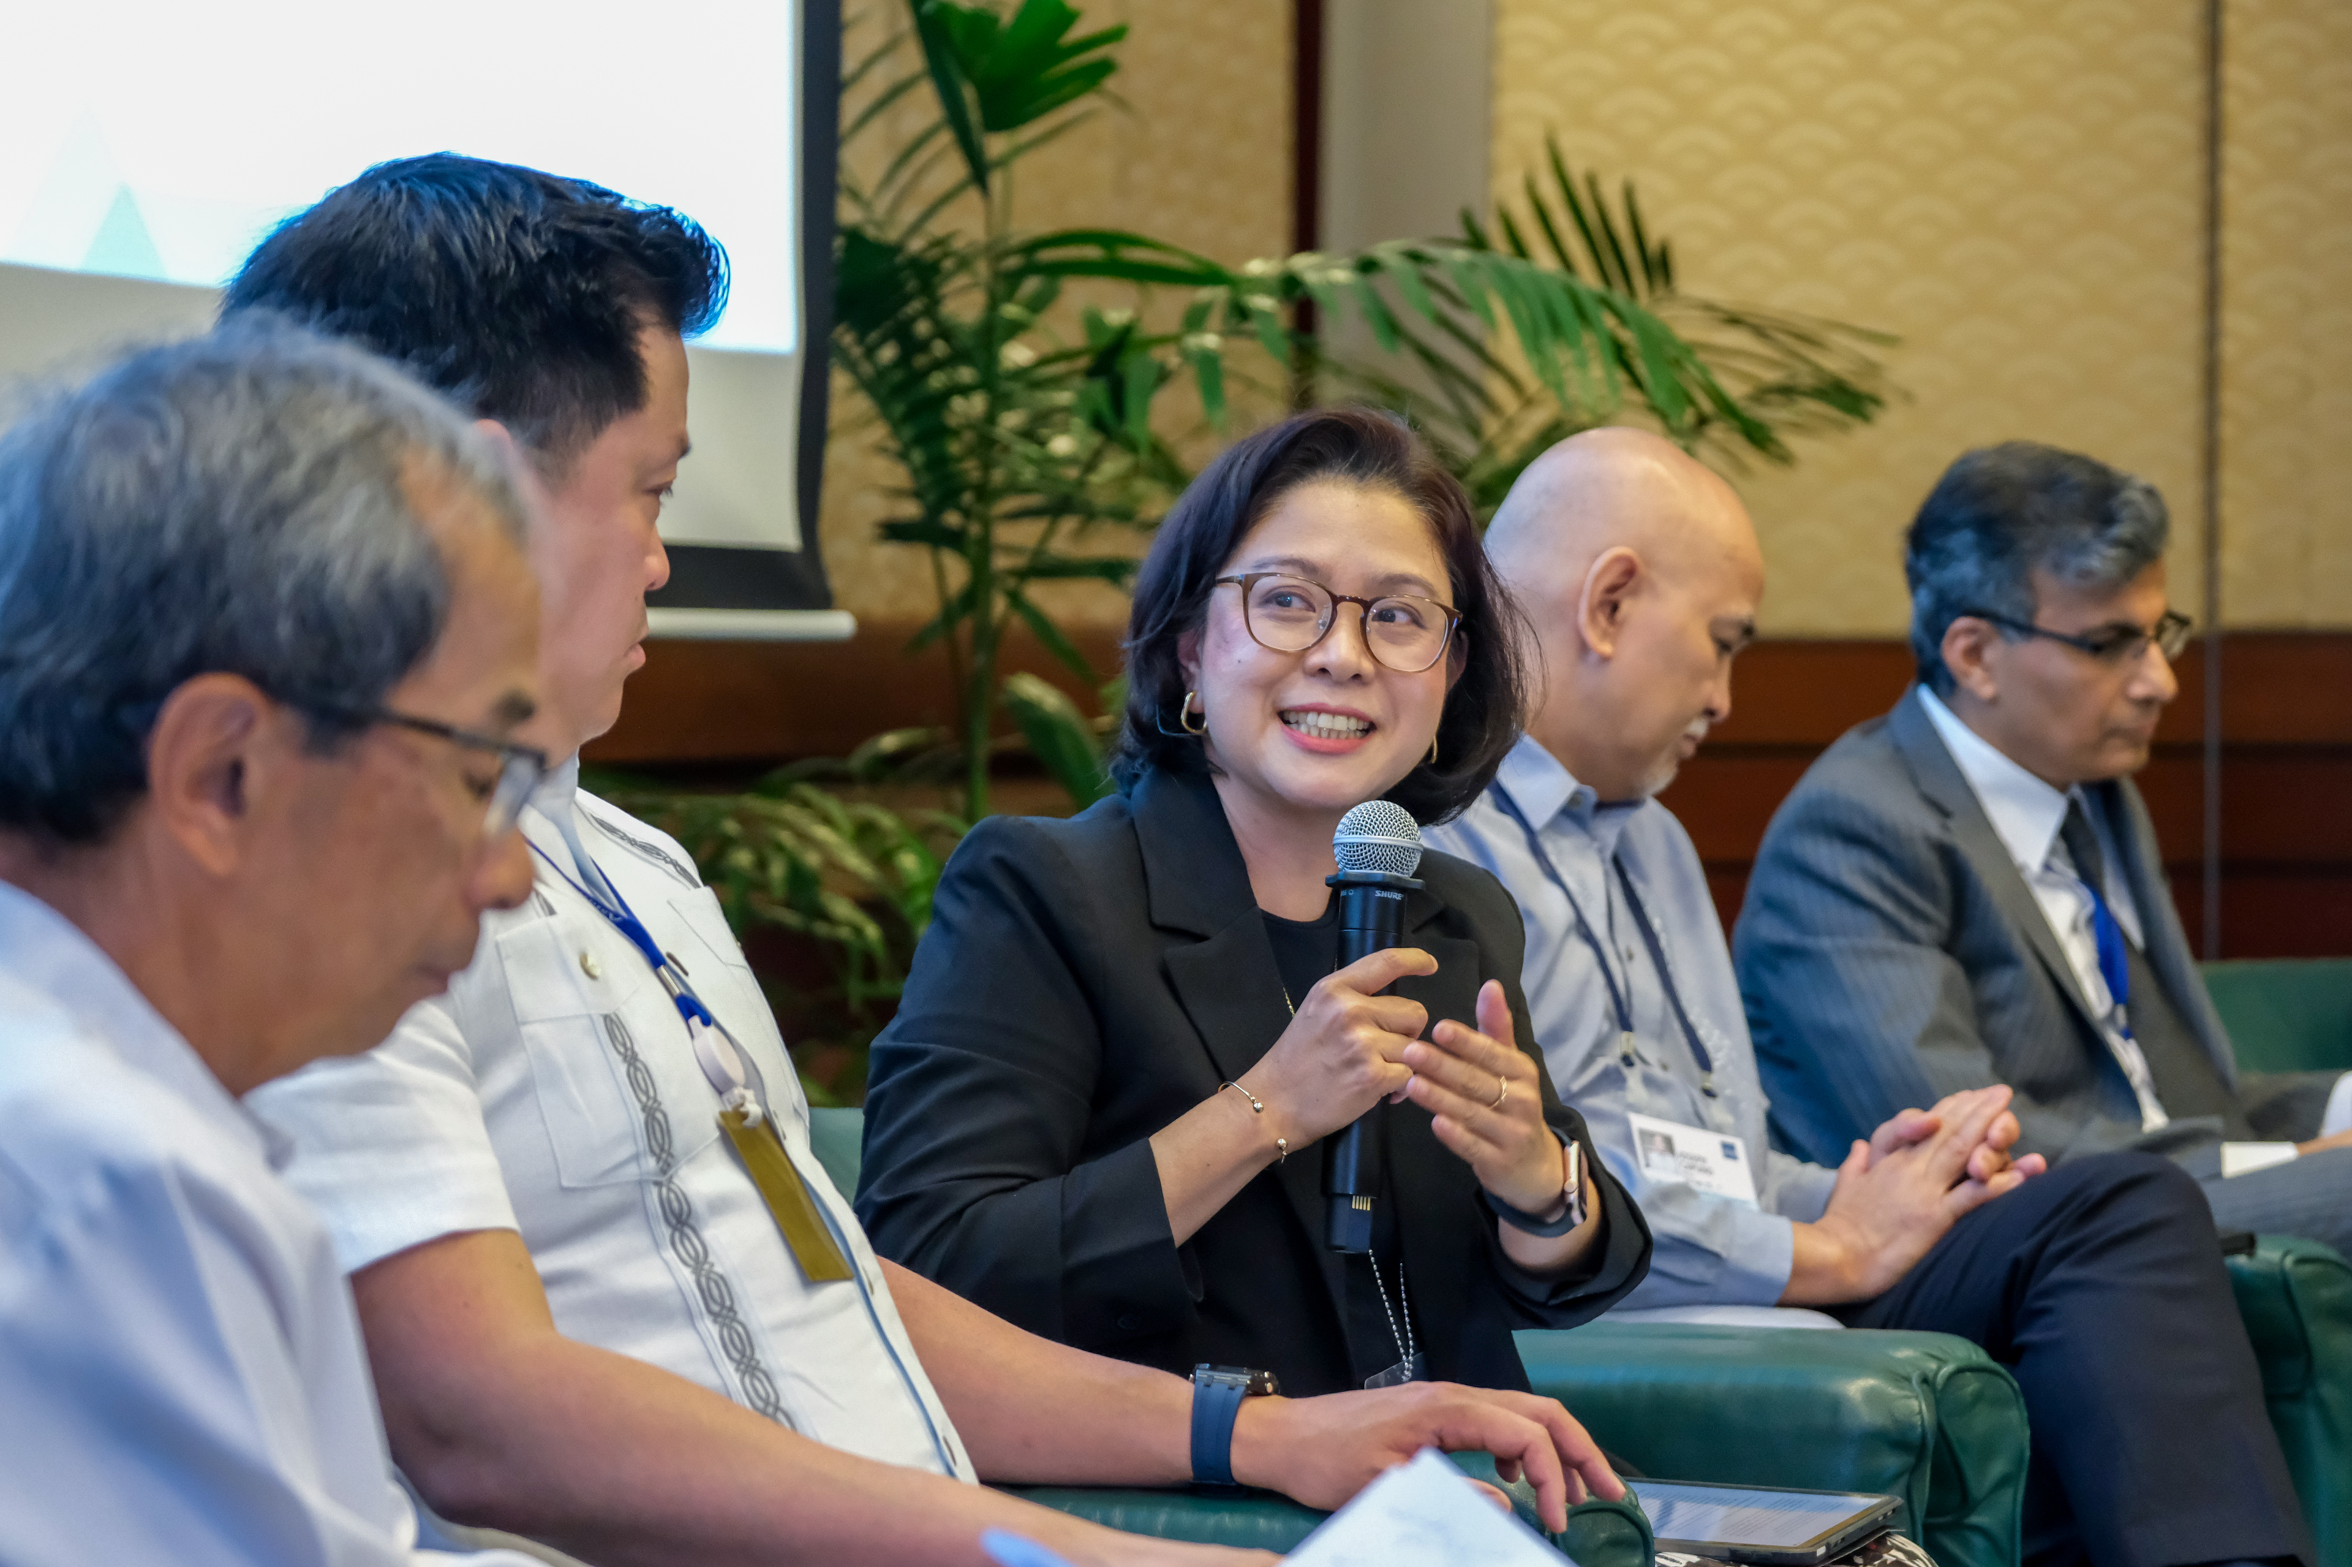
IED’s Just-in-Time Knowledge Initiatives
Country Engagement Missions: Tailored, strategic engagement with Developing Member Countries (DMCs) to maximize the use of just-in-time knowledge
Outcomes and Opportunities:
Two-Way Communication: Facilitates feedback from countries and open dialogue.
Breaking Silos: Provides opportunities for collaborative thinking among various government agencies.
Philippines
PBLs,PPP, Climate Change, Gender
Sri Lanka
Crisis Reform Agenda
Notes:
Examples of Impact
- Sri Lanka: Fielded a CEM to support knowledge needs of Sri Lanka’s Post Crisis Reform Agenda.
- Philippines: Addressed needs for information on PPP, Climate Change, and Gender.

Slide 6
IED’S Just-in-Time Knowledge Initiatives
Country Synthesis Notes: A synthesis of country-specific evaluation lessons that span across ADB’s priority themes and sectors.
Adapting IED’s Communication Approach to Align with Changes in the Organizational Structure (NOM): ADB has transitioned from a country-focused to a sector-focused approach. IED is now engaging with various sectors to provide streamlined knowledge.
Notes:
Adapting IED’s Communication Approach to Align with Changes in the Organizational Structure (NOM):
IED has collaborated with the Agriculture and Natural Resources Sector, Finance Sector, and Regional Cooperation, as well as the Strategy, Policy, and Partnerships Department (SPD), the Procurement, Portfolio and Financial Management Department (PPFD), and IED on streamlining all three annual reports.

Slide 7
According to Schedule:
Communication Plans at the EAP Stage
Communications During the Evaluation Cycle
Timeliness of the News Release
What Works, What Doesn’t and Why: Insights from Evaluation event
Using Global Platforms to Showcase IED’s evaluations
Notes:
Mandating Communication Plans at the EAP Stage: Evaluation teams felt they moved from one evaluation to another without sufficient time to disseminate knowledge from the reports. Additionally, there were no resources allocated for this task. This step addressed both these issues increasing ownership of communications.
Communications During the Evaluation Cycle: Providing information to external stakeholders about upcoming evaluations lends transparency to the process. Our teams now post pictures of interviews and case studies, addressing the issue of non-transparency and enhancing the credibility of the evaluation process through timely dissemination.

Slide 8
Challenges to Timely Dissemination of Evaluations in IED
Lack of incentives: Without motivation or rewards for sharing knowledge, team leaders perceive communications as “additional work” and deprioritize this task.
Lack of ownership by evaluation teams for timely dissemination places additional responsibilities on the communications team, leading delays to the process.
Skill gaps: Many IED staff do not feel confident using social media increasing the dependence on the communications team.
ADB’s corporate communications unsupportive: evaluation findings seen as reputational risk for ADB
Government agencies' emphasis on daily tasks often hinders their ability to see the bigger picture and prioritize learning from experiences.
Notes:
Lack of incentives:
Without motivation or rewards for sharing feedback and results team leaders deprioritize this task, leading to delays or insufficient communication.
Resource Limitations: Limited staff, time, or budget can impede the efficiency of the communication process.
Seen as a task of just communicators.
Loss of trust in social media. Currently only 111 percent of IED Staff is on linked in
Training and Development**: Providing training on effective communication and knowledge sharing techniques can help leaders understand the importance of these practices and how to implement them effectively.
**Leadership by Example**: Senior leaders should model the desired behavior by actively sharing their own knowledge and evaluation results. This sets a precedent and encourages others to follow suit.
Feedback and Improvement**: Creating mechanisms for feedback on the knowledge-sharing process can help identify barriers and areas for improvement, ensuring that the system evolves and becomes more efficient over time.

Slide 9
Thank you
Independent Evaluation at ADB
Instagram
LinkedIn
Twitter
YouTube
Website
Email

