Slide 1
Lessons from IEG’s latest experiments with GenAI for evaluation
Harsh Anuj
Data Scientist
Methods Advisory Function
March 10th, 2025

Slide 2
Context: GenAI and data science in IEG
Remote sensing analysis
Data science
Text mining
Image feature extraction
Natural Language Processing (NLP)
Text analytics
Spatial analytics
Descriptive and statistical analytics
Supervised image classification
Large Language Model (LLM)
Descriptive analysis
Statistical analysis
Spatial overlay analysis

Slide 3
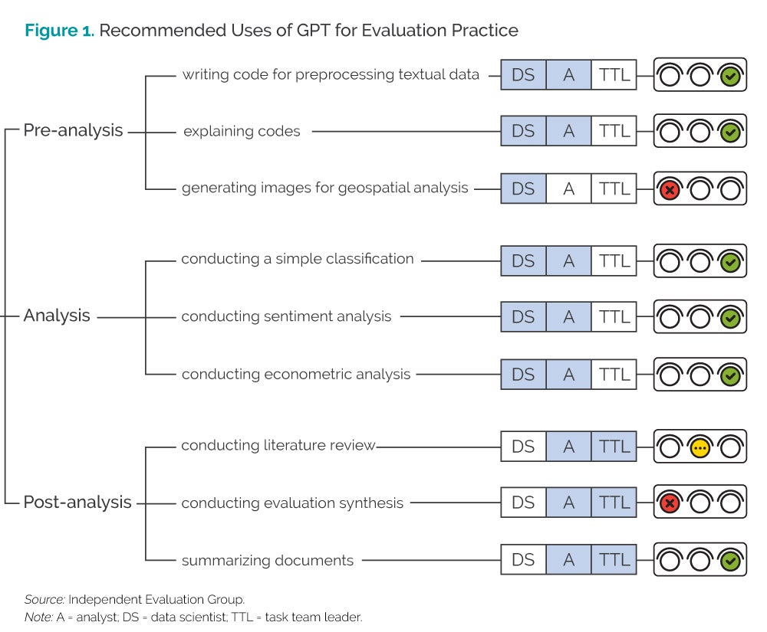
Recap: results of our experiments in 2023
Recommendation
Task / use case
Actor(s)
Analysis stage

Slide 4
Update: products with GenAI applications
Adaptive social protection: WB’s internal chatbot mAI used to prepare thematic summaries and taxonomies based on project documents for portfolio analysis.
Learning in World Bank lending: GPT-4 API used to code information from project design documents about sources of explicit knowledge used in operations.
Biodiversity: Mistral AI’s open SLM and text mining used to identify the portfolio of biodiversity-related WB operations to be included in the evaluation.
Multiphase Programmatic Approach: OpenAI embeddings to identify matched comparators for MPA projects by similarity of project design and country context text.
Electricity Access: GenAI used to extract information from project documents and National Electrification Plans (NEP) of 26 countries in the evaluation scope.
Pandemic Preparedness: GPT-4o API used to screen the relevance of thousands of research papers to 10 topics of a Structured Literature Review (SLR).
IDA support to jobs: GPT-4 used to classify whether results indicators measured outcomes or outputs in jobs-related projects.
Procurement system: WB’s internal chatbot mAI used to summarize responses to open-ended questions in a staff survey as part of the evaluation’s data collection.

Slide 5
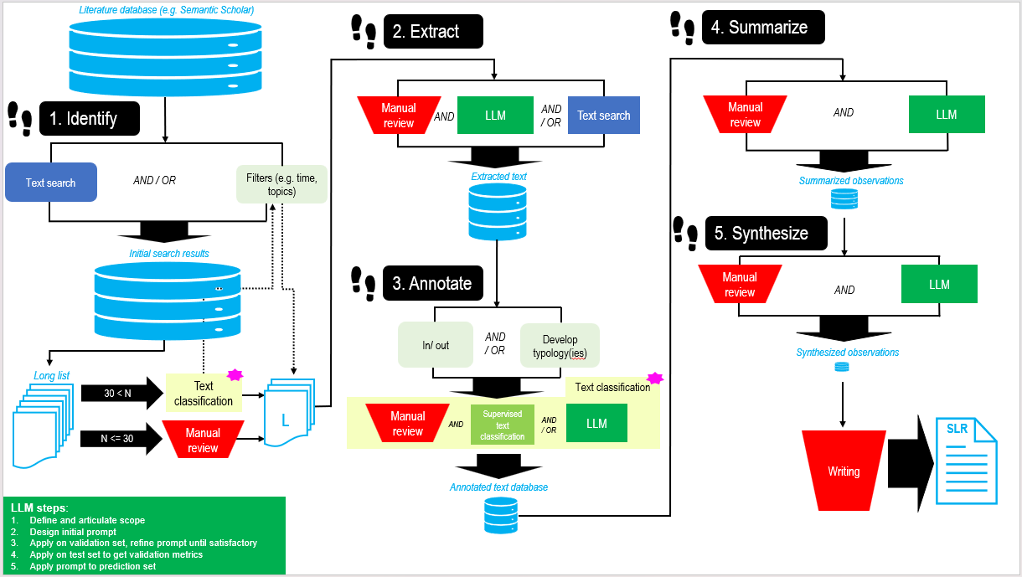
Closer look: GenAI for Structured Literature Review (SLR)

Slide 6
Challenges and Lessons: GenAI for SLR
Challenges | Lessons
Selecting use cases. | Focus on areas where GenAI adds significant value. Align experiments with tasks that leverage GenAI capabilities.
Identifying opportunities within use cases. | Break down tasks into granular steps. Reuse successful components across workflows.
Setting expectations and measuring outcomes. | Understand and agree on necessary resources up-front. Define and agree on what success would look like for each use case. Use appropriate metrics to quantify performance of LLMs.
Enhancing validity of LLM outputs. | Use appropriate metrics to quantify performance of LLMs. Careful, representative sampling for generalizability. Iterative prompting and validation.

Slide 7
Going forward: updates to our traffic lights

Slide 8
Thank You!
https://ieg.worldbankgroup.org/
hanuj@worldbank.org

