Slide 1
March • 2025
CABEI’s Experience with Private Sector: findings and exploring the way forward
Independent Evaluation Office (ODEI)

Slide 2
Big Book GPS on Private Sector
1
It reflects the project /company’s financial performance and achievement of project business objectives.
FPR, ROIC, achievement of appraisal projections and project business objectives, analysis of financial statements (sales, net profit, FIRR), business overall profitability, adaptability and prospects for sustainability and growth, and the performance of the Intermediary.
Financial Criteria
2
It reflects the project /company’s contribution to economic growth
Assessing the project’s overall economic impact. The metrics consider stakeholders beyond the project company’s owners and financiers and, therefore, the wider economic contributions of the project beyond those measured by project financial performance alone.
Economic Criteria
Notes:
evaluation metrics and benchmarks.
Financial performance is a measure of the project’s impact on its financial stakeholders, who represent a subset of all of the project’s economic stakeholders.

Slide 3
Big Book GPS on Private Sector
It reflects the project /company’s contribution to the IFI’s mandate objectives
Stimulate development of the private sector, development of efficient financial markets, or transition to a market economy. Competition, market expansion and entrepreneurship; frameworks for markets; transfer and dispersion of skills; standards for corporate governance; development of financial institutions; attracting FDI flows; and development of physical infrastructure. Sustainable positive impacts.
3
IFI Mandate Criteria
4
Driving innovative solutions to climate change
The assessment is based on the project company’s management of its E&S aspects. Considering the adequacy of the financial intermediary’s or fund manager’s Environmental & Social Management System (ESMS) and its implementation.
Environmental and Social (E&S) Criteria

Slide 4
Big Book Private Sector Principles – Rating Project Outcomes
CABEI’s evaluation instrument modules
Big Book GPS and CABEI’s Evaluation Metrics
Inputs
Investment
Outputs
Outcomes
Institutional Performance
Economic Sustainability
E&S Performance
Gender
Poverty
Financial performance
Economic sustainability
Contribution to IFI mandate
E&S performance

Slide 5
Impact
Tailored financial solutions delivered to the private sector strengthen regional integration, productivity, competitiveness, and innovation by facilitating the adoption and development of transformative technologies, unlocking sustainable development impact across countries.
Financial Intermediaries
Private Sector Projects
PPP Projects
Outcomes
Strengthened capacity and financial performance of financial intermediaries through tailored products and differentiated approaches enable expanded financial access for MSMEs, driving economic growth, job creation, and inclusive development.
Funds for MSME channeled through financial intermediaries through differentiated approaches to address varying needs.
Design differentiated financial products and mechanisms, enabling intermediaries to channel funds effectively and expand MSME financial access.
FI may lack the capacity or willingness to adopt and implement differentiated approaches.
Financial intermediaries have the capacity, willingness, and incentives to adopt and implement tailored financial products, ensuring equitable access to funds for MSMEs, including underserved enterprises.
Facilitated private sector (PS) participation in infrastructure development through structured project finance enables successful projects in key sectors, boosting PS engagement, driving regional development, and creating economic growth and job opportunities.
Tailored financial products and structured project finance deals to attract private sector investment in infrastructure projects.
Establish research, policies, stakeholder collaboration, financial expertise, capacity-building, pilot projects, and funding to create tailored financial solutions that attract private investment for infrastructure and regional development.
Increased PPP projects in key sectors, supported by modernized regulations and improved risk allocation, drive foreign investment, regional competitiveness, and social benefits like enhanced public services and infrastructure for local communities.
Modernized PPP regulations to create a more enabling environment for investment and risk-sharing, with standardized frameworks and tools developed to streamline PPP processes, ensure greater accountability, and optimize project.
Establish stakeholder collaboration, technical expertise, capacity-building, and funding to strengthen institutions, streamline processes, and create an enabling environment for increased PPP projects, foreign investment, and regional competitiveness.
Outputs
Activities
Risks
Private sector investors may remain hesitant due to perceived risks or lack of attractive returns.
Assumptions
Enabled conditions for the private sector.
Private sector actors and investors have the confidence, capacity, and willingness to engage in infrastructure projects, driven by clear regulatory frameworks, attractive risk-return profiles, and reliable enforcement mechanisms.
The interests of the private and public sectors are aligned, ensuring collaborative efforts in designing and implementing PPP projects that balance profitability, public service delivery, and sustainable development goals

Slide 6
Impact
Tailored financial solutions delivered to the private sector strengthen regional integration, productivity, competitiveness, and innovation by facilitating the adoption and development of transformative technologies, unlocking sustainable development impact across countries.
Financial Intermediaries
Private Sector Projects
PPP Projects
Financial Intermediaries
Financial Intermediaries
Outcomes
Strengthened capacity and financial performance of financial intermediaries through tailored products and differentiated approaches enable expanded financial access for MSMEs, driving economic growth, job creation, and inclusive development.
Funds for MSME channeled through financial intermediaries through differentiated approaches to address varying needs.
Design differentiated financial products and mechanisms, enabling intermediaries to channel funds effectively and expand MSME financial access.
Financial intermediaries may lack the capacity or willingness to adopt and implement differentiated approaches.
Financial intermediaries have the capacity, willingness, and incentives to adopt and implement tailored financial products, ensuring equitable access to funds for MSMEs, including underserved enterprises.
Facilitated private sector (PS) participation in infrastructure development through structured project finance enables successful projects in key sectors, boosting PS engagement, driving regional development, and creating economic growth and job opportunities.
Tailored financial products and structured project finance deals to attract private sector investment in infrastructure projects.
Establish research, policies, stakeholder collaboration, financial expertise, capacity-building, pilot projects, and funding to create tailored financial solutions that attract private investment for infrastructure and regional development.
Increased PPP projects in key sectors, supported by modernized regulations and improved risk allocation, drive foreign investment, regional competitiveness, and social benefits like enhanced public services and infrastructure for local communities.
Modernized PPP regulations to create a more enabling environment for investment and risk-sharing, with standardized frameworks and tools developed to streamline PPP processes, ensure greater accountability, and optimize project execution.
Establish stakeholder collaboration, technical expertise, capacity-building, and funding to strengthen institutions, streamline processes, and create an enabling environment for increased PPP projects, foreign investment, and regional competitiveness.
Impact at the household level, enterprises, improvements and acquisition of assets, borrower behavior, Degree of borrowers' satisfaction of sub-borrowers. FI perceptions.
Stage 2
Assessing the Impact of Microenterprise Services (AIMS)
Outputs
Financial situation, use of the programs that the CABEI has for the FI. E&S performance
Stage 1
FI Monitoring Report
Activities
Risks
Private sector investors may remain hesitant due to perceived risks or lack of attractive returns.
Assumptions
Private sector actors and investors have the confidence, capacity, and willingness to engage in infrastructure projects, driven by clear regulatory frameworks, attractive risk-return profiles, and reliable enforcement mechanisms.
The interests of the private and public sectors are aligned, ensuring collaborative efforts in designing and implementing PPP projects that balance profitability, public service delivery, and sustainable development goals

Slide 7
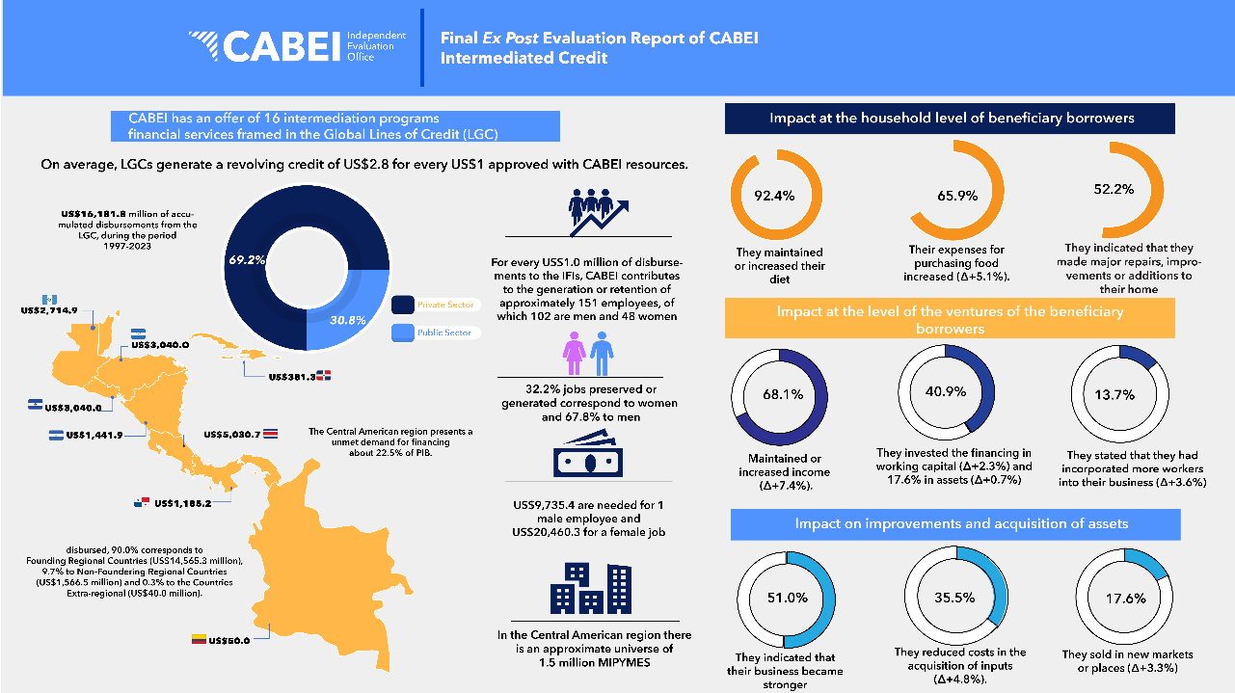
Notes:
Mencionar bullets de otra ppt

Slide 8
Impact
Tailored financial solutions delivered to the private sector strengthen regional integration, productivity, competitiveness, and innovation by facilitating the adoption and development of transformative technologies, unlocking sustainable development impact across countries.
PPP Projects
PPP Projects
Private Sector Projects
PPP Projects
Financial Intermediaries
Private Sector Projects
Private Sector Projects
Strengthened capacity and financial performance of financial intermediaries through tailored products and differentiated approaches enable expanded financial access for MSMEs, driving economic growth, job creation, and inclusive development.
Funds for MSME channeled through financial intermediaries through differentiated approaches to address varying needs.
Design differentiated financial products and mechanisms, enabling intermediaries to channel funds effectively and expand MSME financial access.
Financial intermediaries may lack the capacity or willingness to adopt and implement differentiated approaches.
Financial intermediaries have the capacity, willingness, and incentives to adopt and implement tailored financial products, ensuring equitable access to funds for MSMEs, including underserved enterprises.
Facilitated private sector (PS) participation in infrastructure development through structured project finance enables successful projects in key sectors, boosting PS engagement, driving regional development, and creating economic growth and job opportunities.
Tailored financial products and structured project finance deals to attract private sector investment in infrastructure projects.
Establish research, policies, stakeholder collaboration, financial expertise, capacity-building, pilot projects, and funding to create tailored financial solutions that attract private investment for infrastructure and regional development.
Increased PPP projects in key sectors, supported by modernized regulations and improved risk allocation, drive foreign investment, regional competitiveness, and social benefits like enhanced public services and infrastructure for local communities.
Modernized PPP regulations to create a more enabling environment for investment and risk-sharing, with standardized frameworks and tools developed to streamline PPP processes, ensure greater accountability, and optimize project execution.
Establish stakeholder collaboration, technical expertise, capacity-building, and funding to strengthen institutions, streamline processes, and create an enabling environment for increased PPP projects, foreign investment, and regional competitiveness.
Outcomes
Job creation, contribution to country economy, E&S performance
Stage 2
Ex Post Evaluation
(Before and After)
Ex Post Evaluation
(Before and After)
Outputs
Project execution, Financial situation, E&S performance
Stage 1
Project Monitoring Report
Project Monitoring Report
Activities
Risks
Private sector investors may remain hesitant due to perceived risks or lack of attractive returns.
Assumptions
Private sector actors and investors have the confidence, capacity, and willingness to engage in infrastructure projects, driven by clear regulatory frameworks, attractive risk-return profiles, and reliable enforcement mechanisms.
The interests of the private and public sectors are aligned, ensuring collaborative efforts in designing and implementing PPP projects that balance profitability, public service delivery, and sustainable development goals

Slide 9
An advantage of the private sector
Market Effects
Drives the economy by creating jobs, generating sales, paying taxes, fostering competition, and market making.
Among CABEI’s private sector financing initiatives, the following stand out:
Financing the first wind energy projects in Guatemala and Honduras.
Supporting a sustainable tourism project that earned Nicaragua a tourism award
Agribusiness
Corporate
Education
Energy
Housing
Roads
Tourism
Notes:
El private sector es el encargado de generar mercados que no son generados por el sector públicos (el SP si se necesita para el enabling environment).. MDBs se necesitan para fomenter esa union.
El caso de Honduras, el 100% de la generación eólica y Guatemala el 70% de la generación eólica.
When we are looking for

Slide 10
Our way forward
Theory of change (ToC)
Do we have a common approach on the ToC in the private sector?
How can the Good Practice Standards for Evaluation of Private Sector Investment Operations (GPS) be redesigned to better capture the development impact of private sector projects, particularly in underserved sectors and regions, and how can non-financial additionality be effectively evaluated to demonstrate the unique value MDBs bring?
Enable business environment
What are we doing as MDBs to enable those conditions to finance private?
What role can evaluation play in improving the design and implementation of PPPs and tailored financial products to ensure they deliver both financial returns and sustainable development outcomes?
Notes:
What are we doing as MDBs to enable business environments for the private sector (para tener el trust del private sector en nuestros países) – necesitas que el sector privado confie en el pais pero que estamos haciendo como MDBs para enable esas condiciones para financiar privado.
How can the Good Practice Standards for Evaluation of Private Sector Investment Operations (GPS) be redesigned to better capture the development impact of private sector projects, particularly in underserved sectors and regions, and how can non-financial additionality (e.g., technical expertise, catalytic effects, and development alignment) be effectively evaluated to demonstrate the unique value IFIs bring?

